Slide 1

Artificial Intelligence
(AI)

Slide 2
AGENDA
Feed Forward Neural Network
Backpropagation
Activation Functions
Loss functions
Optimizers

Slide 3
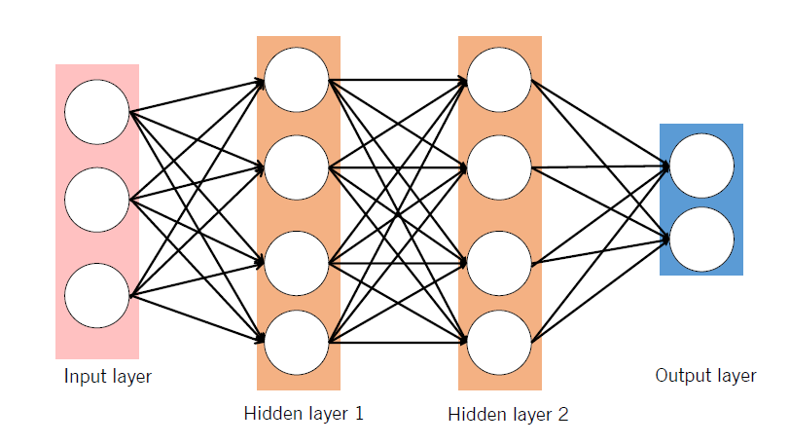
Feedforward Neural Network
Back to main

Slide 4


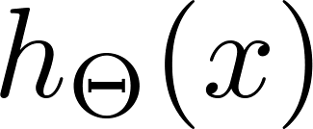




Neural Network learning its own features
Layer 1
Layer 2
Layer 3

Slide 5
Other network architectures
Layer 1
Layer 2
Layer 3
Layer 4

Slide 6
Backpropagation
Back to main

Slide 7
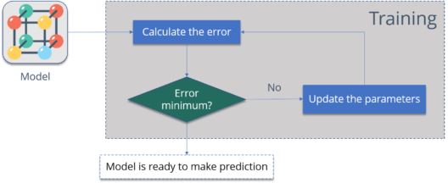
Why We Need Backpropagation?
Let me summarize the steps for you:
  Calculate the error
  Minimum Error
  Update the parameters
  Model is ready to make a prediction

Slide 8
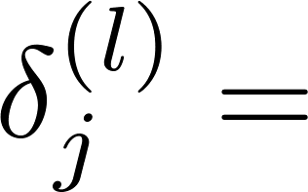

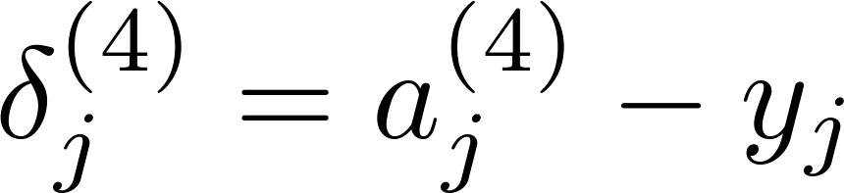
Gradient computation: Backpropagation algorithm
Intuition: “error” of node in layer .
For each output unit (layer L = 4)
Layer 1
Layer 2
Layer 3
Layer 4

Slide 9
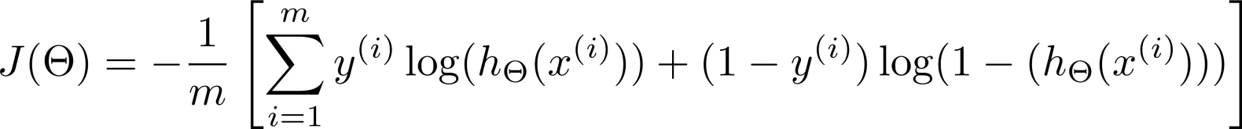
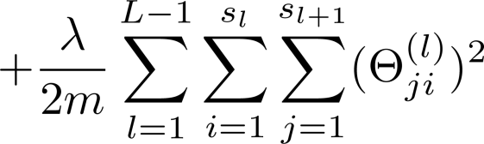



What is backpropagation doing?
Focusing on a single example , , the case of 1 output unit, and ignoring regularization ( ),
(Think of )
I.e. how well is the network doing on example i?
Back to main

Slide 10
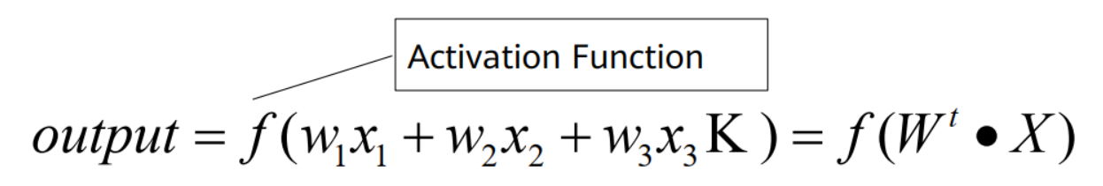
Activation Functions
Activation functions are important for the neural network model to learn and understand complex non-linear functions. They allow introduction of non-linear features to the network
Back to main

Slide 11
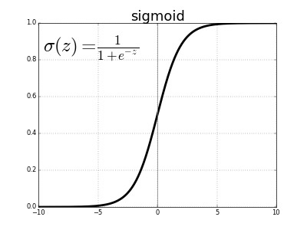
Sigmoid Function

Slide 12
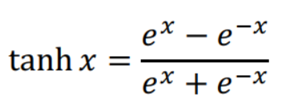
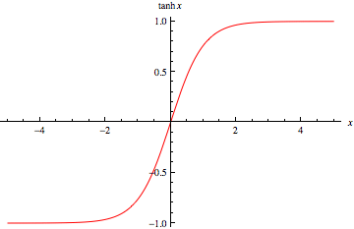
Tanh Function

Slide 13
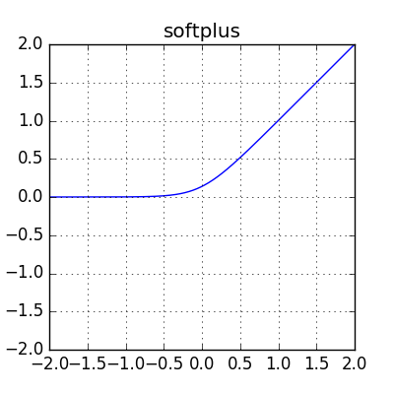

Softplus function

Slide 14
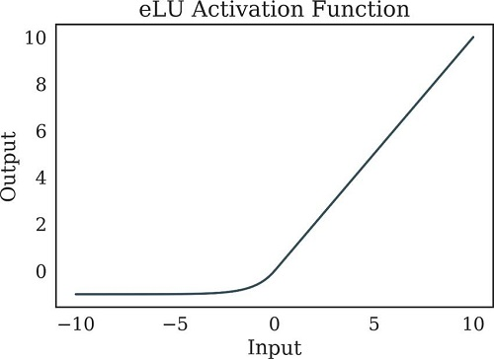
ReLU Function
Back to main

Slide 15
Loss functions
Back to main

Slide 16
Loss functions
Loss function is a mathematical function that calculates the difference between the predicted output of a model and the actual output. Common loss functions are:
  Mean Squared Error (MSE): For regression problem
  Mean Absolute Error (MAE): For regression problem
  Binary Cross-Entropy: For binary classification problem
  Categorical Cross-Entropy: For multi classification problem
  Sparse Categorical Cross-Entropy: For multi classification problem when the labels are integer.
Back to main

Slide 17
Optimizers
Back to main

Slide 18
Optimizers
In deep learning, an optimizer is an algorithm that adjusts the weights and biases of a neural network during training to minimize the loss function.
Common optimizers: common GD optimizer, momentum optimizer, Nesterov, AdaGrad, AdaDelta, RMSProp, Adam, AdaMax, and Nadam
Back to main

